Slide 1
Vélib’ Métropole
Jasmijn Bartelds, Jan hendrik hille, Erik Knaake, Sabrina trebing & Baris Urhan
Notes:
Baris

Slide 2
Agenda
Overview
Business rules
Verbalization & Analysis
FCO-IM & ER Model
Work process and experiences
Notes:
Baris

Slide 3
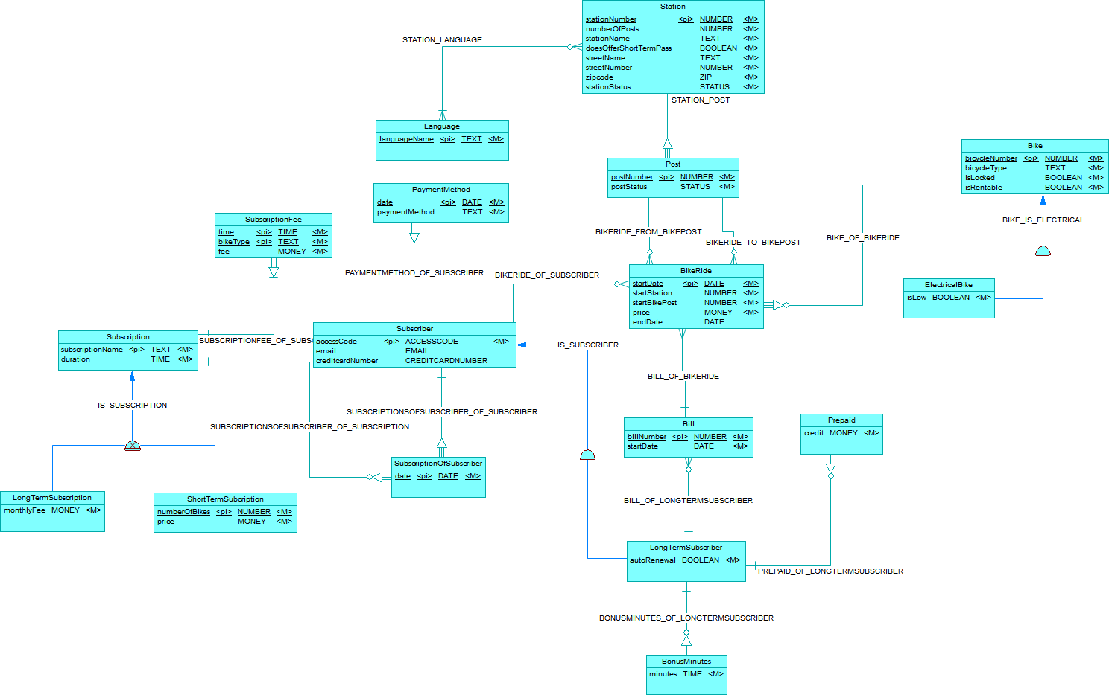

Overview ER
Notes:
Erik

Slide 4
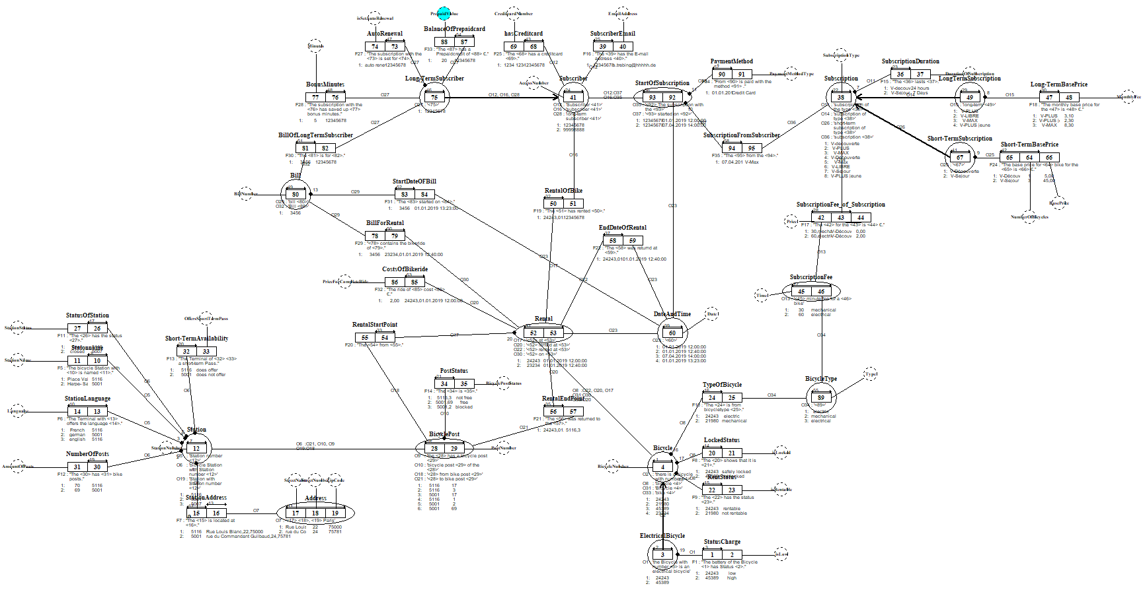
Overview FCO-IM
Notes:
Sabrina

Slide 5
Business rules
If the battery of a bike is low and it is parked in a bike post, the bike must be locked
A subscriber can only save and use bonus minutes if the subscription is of type 'V-Plus' or 'V-Max’
A subscriber can only have one active subscription
A bike can´t be taken if the bike post is blocked
All bike posts on a station should be blocked if a station is closed
If a bike is blocked at a post or being repaired at a workshop, it can´t be rented
Notes:
Jan

Slide 6
Verbalization & Analysis
There is a subscriber with access code 12345678 ET Subscriber ID Att accessCode
The subscriber with access code 12345678 has the E-mail address s.trebing@outlook.com ET Subscriber Att email Match
The Subscriber with subscriber access code 12345678 has a prepaid card with number 12345678. ET LongTermSubscriber ET Prepaid ID: ET Subscriber ID: ET LongTermSubsciber RT Prepaid_OF_LongTermSubscriber between Prepaid (dependent) and LongTermSubscriber RT LongTermSubscriberOfSubscriber between Subscriber and LongTermSubscripter (dependent)
The long-term subscription with the subscriber access code 12345678 is set for auto renewal ET LongTermSubscriber Att autorenewal MATCH
Notes:
Baris

Slide 7
The long-term subscription with the subscriber access code 12345678 has saved up 5 bonus minutes ET BonusMinutes Att minutes ID: ET LongTermSubscriber RT BonusMinutesOfLongTermSubscriber between BonusMinutes (dependent) and LongTermSubscribers.
The subscription V-MAX from the subscriber with access code 12345678 started on 07.04.2019 14:00 ET SubscriptionOfSubscriber ID: ET Subscriber + ET Subscription + Att date
The subscriber 12345678 has the payment method credit card since 01.01.2019 RT SubscriptionsOfSubscriber_Of_Subscriber between SubscriptionOfSubscriber (dependent) and Subscriber RT SubscriptionsOfSubscriber_Of_Subscription between SubscriptionOfSubscriber (dependent) and Subscription
Notes:
Baris

Slide 8
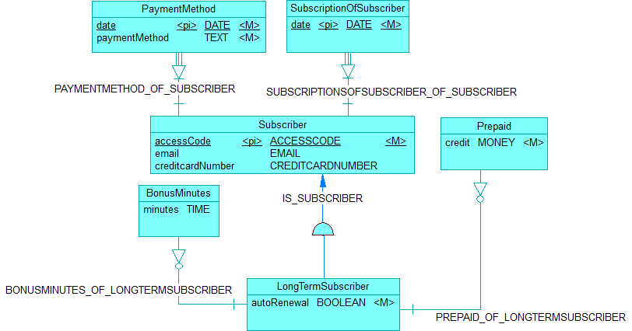
ER Model of subscribers
Notes:
Baris

Slide 9
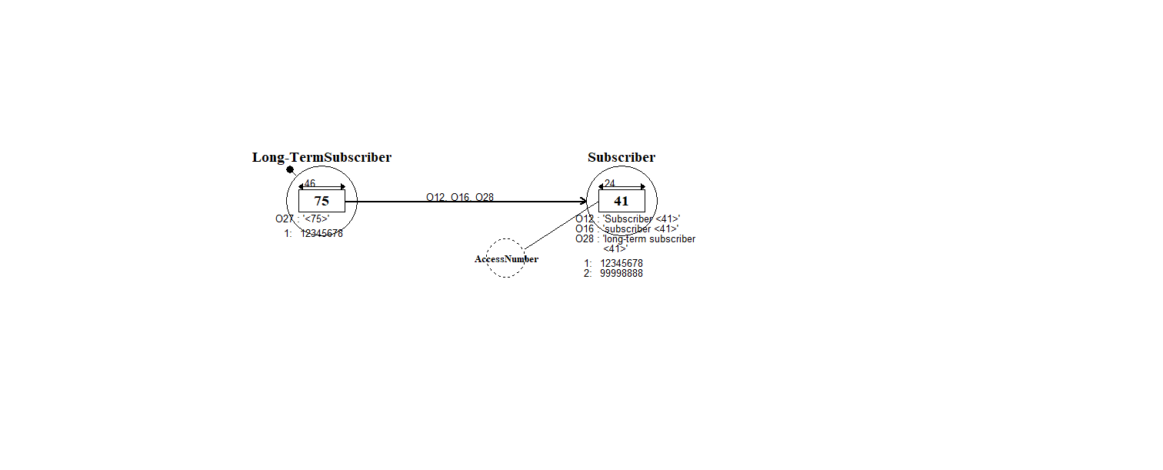
FCO-IM Model of subscribers

Slide 10
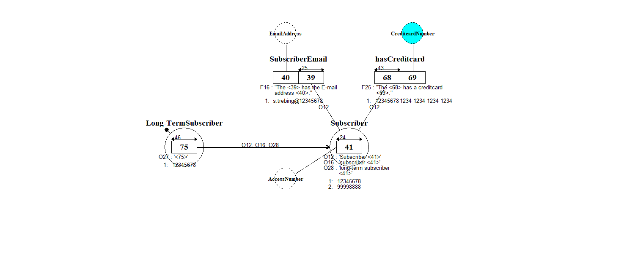
FCO-IM Model of subscribers

Slide 11
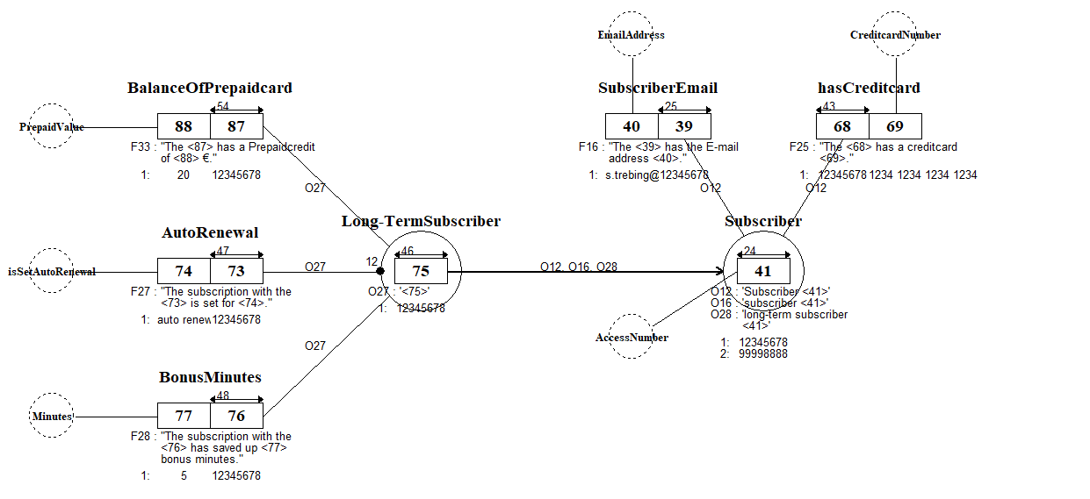
FCO-IM Model of subscribers

Slide 12
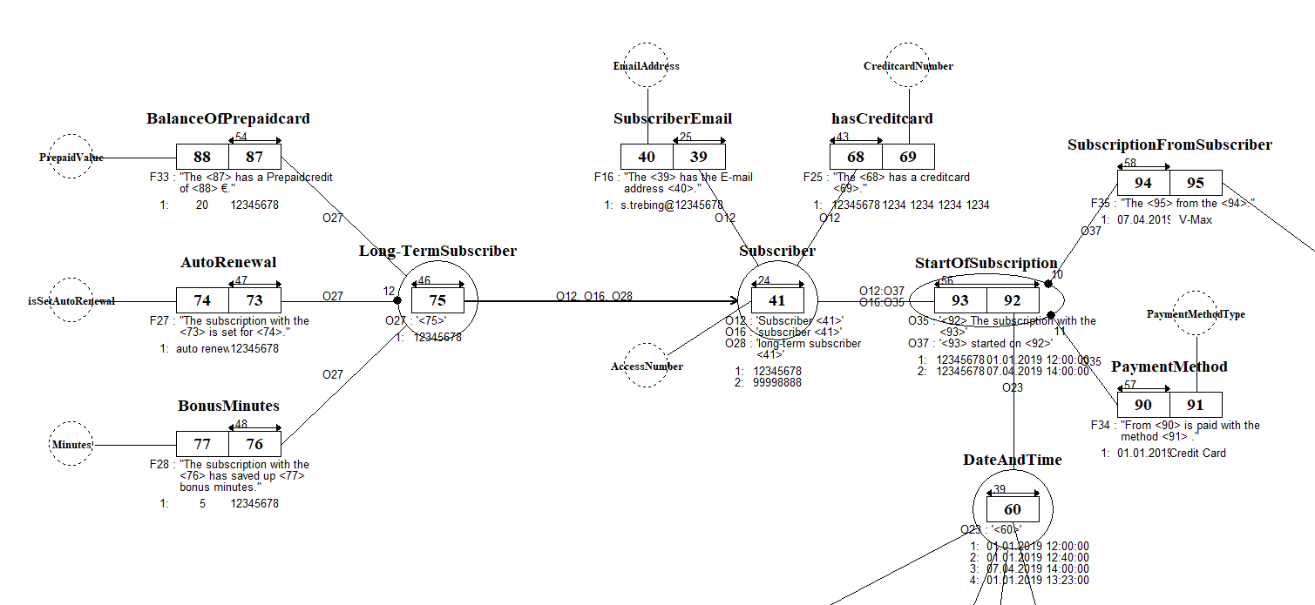
FCO-IM Model of subscribers

Slide 13
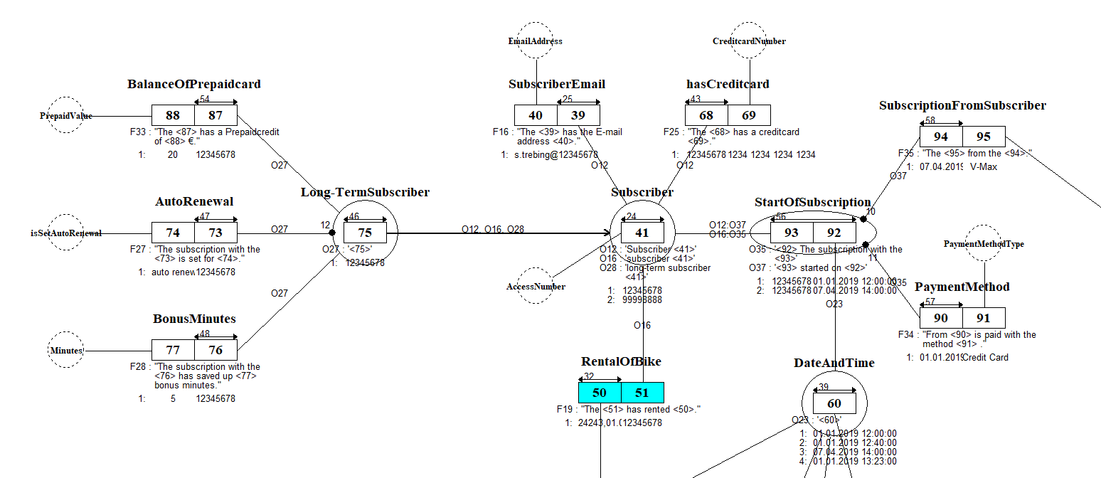
FCO-IM Model of subscribers

Slide 14
Bike rides verbalization & analysis
The bike post 8 of the station with station number 5001 is blocked. ET Post Att postStatus
The subscriber access code 12345678 has rented bike with number 24243 at 01.01.2019 12:00. ET BikeRide Att startDate ID: ET Bike + ET Subscriber RT BikeRide_OF_Subscriber between BikeRide and Subscriber RT Bike_OF_BikeRide between Bike and BikeRide(dependent)
Bike with number 24243 rented at 01.01.2019 12:00 from Station with number 5001 from bike post 17. ET BikeRide Att startStation Att: startBikePost MATCH RT BikeRide_FROM_STATION between BikeRide and Station. RT BikeRide_FROM_BIKEPOST between BikeRide and BikePost.
Bike with number 24243 rented at 01.01.2019 12:00 was returned at 01.01.2019 12:40. ET BikeRide Att: startDate Att endDate MATCH
Notes:
Jasmijn

Slide 15
Bill
There is a Bill with bill number 3456. ET Bil ID ATT billNumber
The Bill with bill number 3456 is for long-term subscriber with subscriber access code 12345678.
ET Bill ET LongTermSubscriber
MATCH MATCH
RT BILL_OF_LONGTERMSUBSCRIBER between Bill and LongTermSubscriber
The bill with bill number 5637 started on 01.01.2019.
ET Bill Att: startDate
MATCH
Bill with bill number 3456 contains the bikeride of the bike with number 23234 on 01.01.2019 12:40.
ET Bill ET BikeRide
MATCH MATCH
RT: BILL_OF_BIKERIDE between Bill and BikeRide.
Notes:
Jasmijn

Slide 16
Bike & electrical bike
There is a bicycle with bicycle number 21980.
ET Bike
ID: Att bicycleNumber
The bicycle with bicycle number 24243 is from bicycletype electric.
ET Bike Att bicycleType
MATCH
The bicycle with bicycle number 21980 shows that it is unlocked.
ET BIKE Att isLocked
MATCH
The electric bicycle with bicycle number 24243 has a low battery.
ET ElectricalBike Att isLow
ID: ET Bike
RT BIKE_IS_ELECTRICAL between Bike and ElectricalBike (dependent)
The bicycle with bicycle number 24243 has the status rentable.
ET Bike Att isRentable
Notes:
Jasmijn

Slide 17
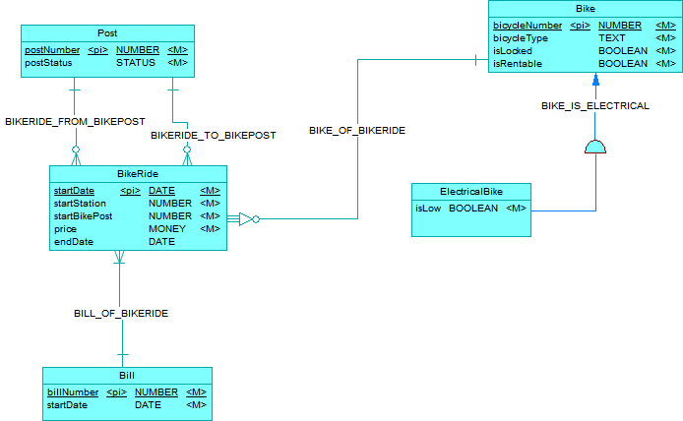
ER Model of bike rides
Notes:
Jasmijn

Slide 18
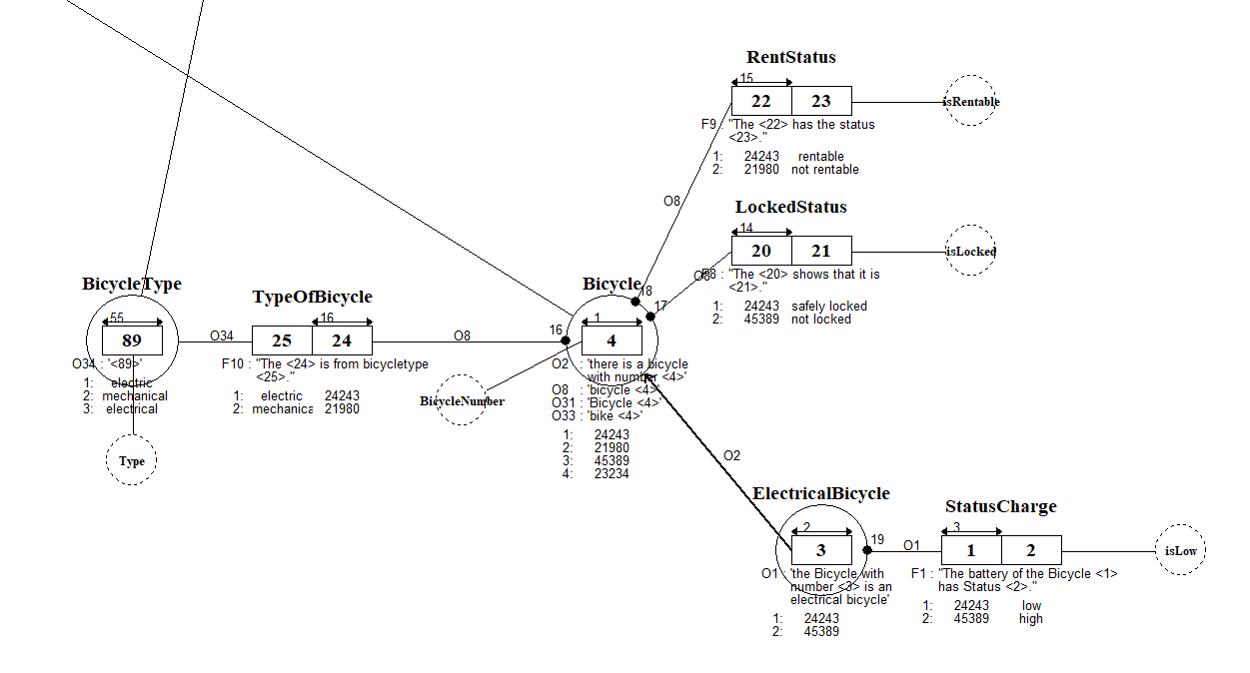
FCO-IM Model of bikeride/rental

Slide 19
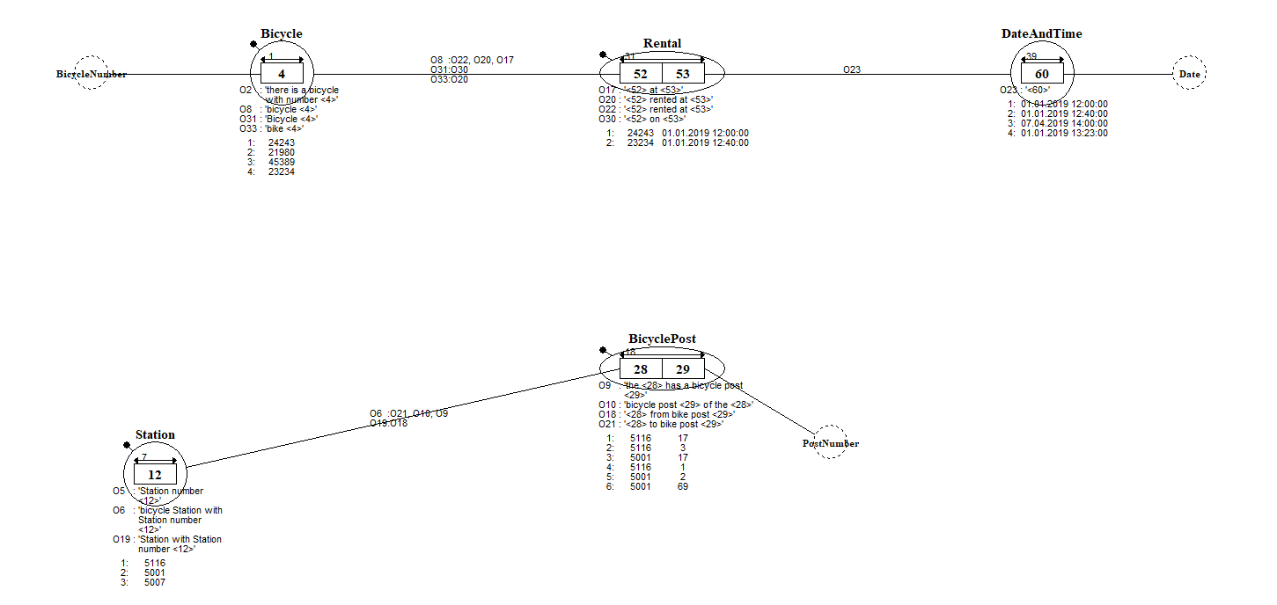
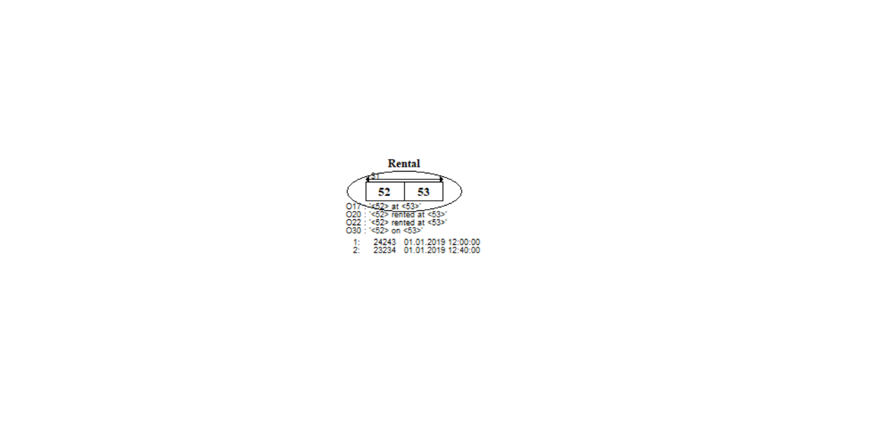
FCO-IM Model of bikeride/rental

Slide 20
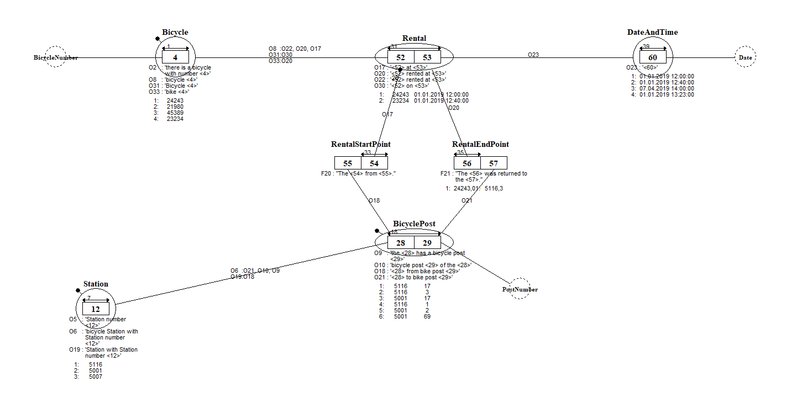
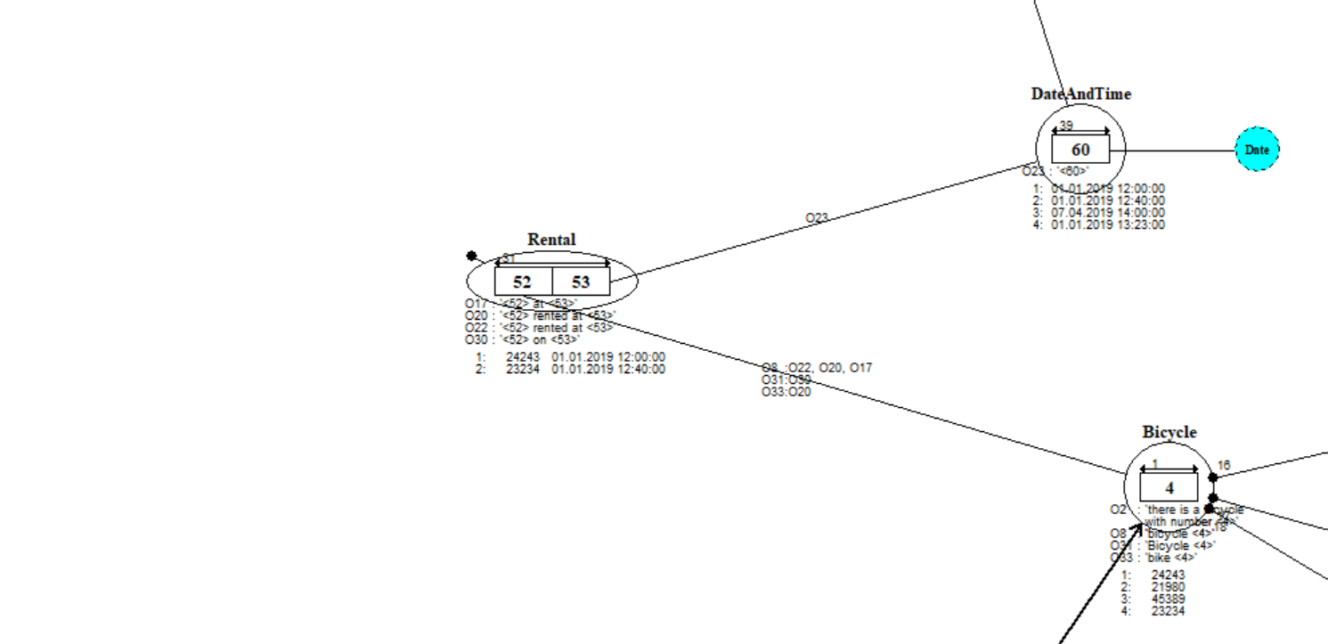
FCO-IM Model of subscriptions

Slide 21
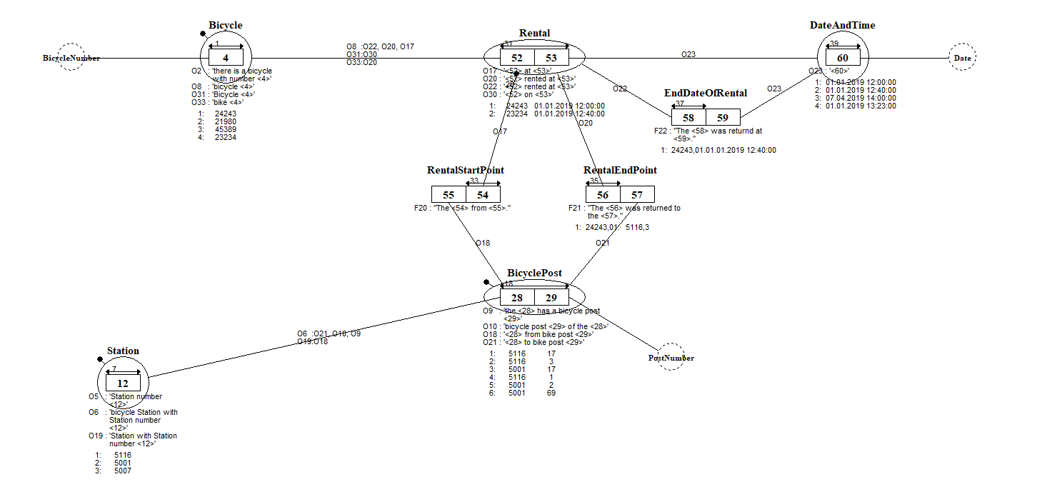
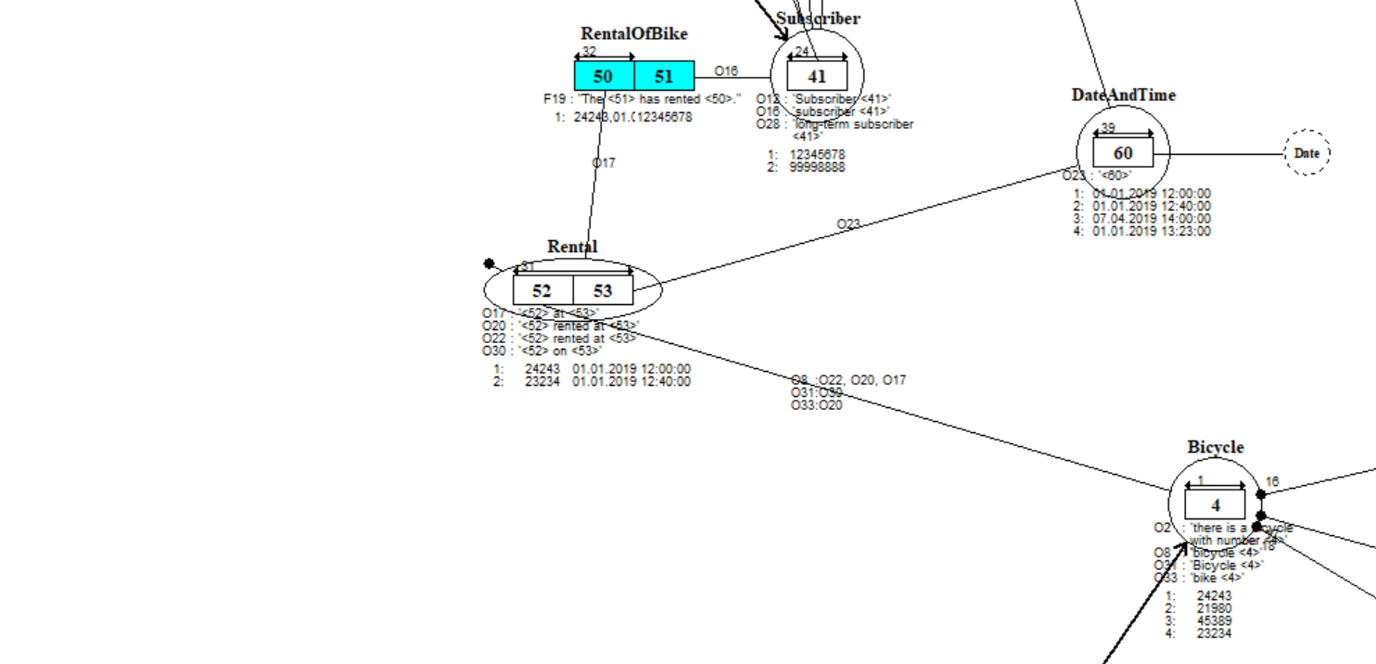
FCO-IM Model of subscriptions

Slide 22
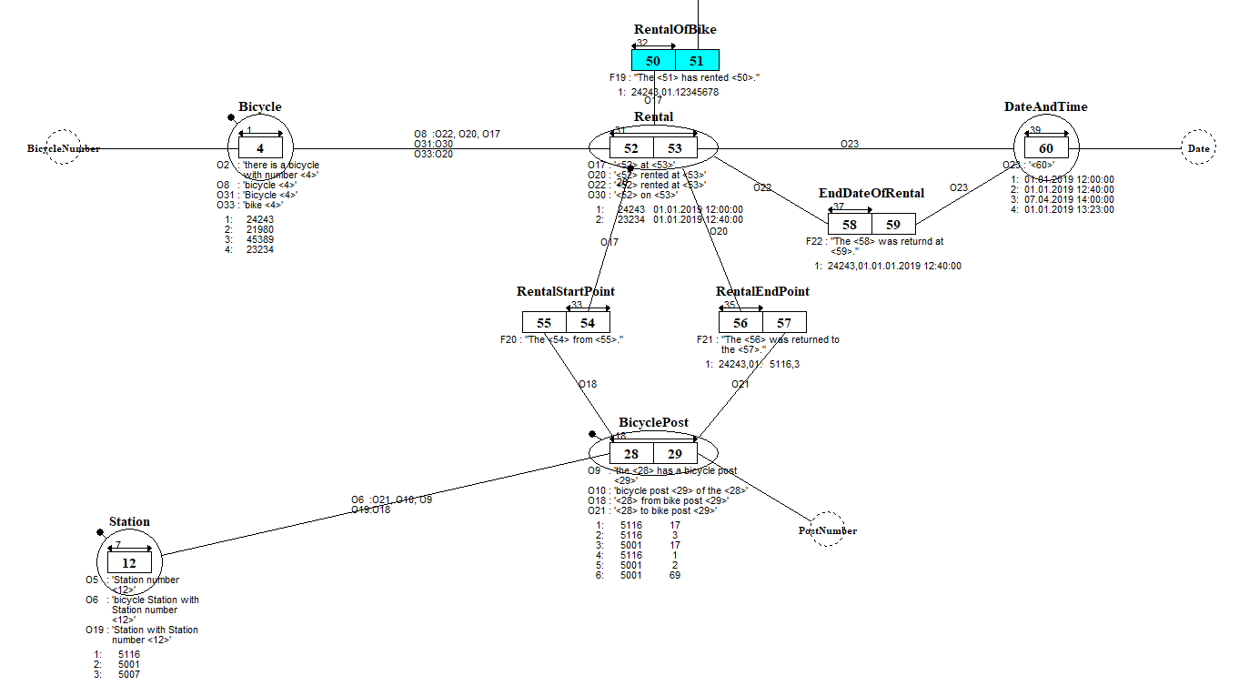
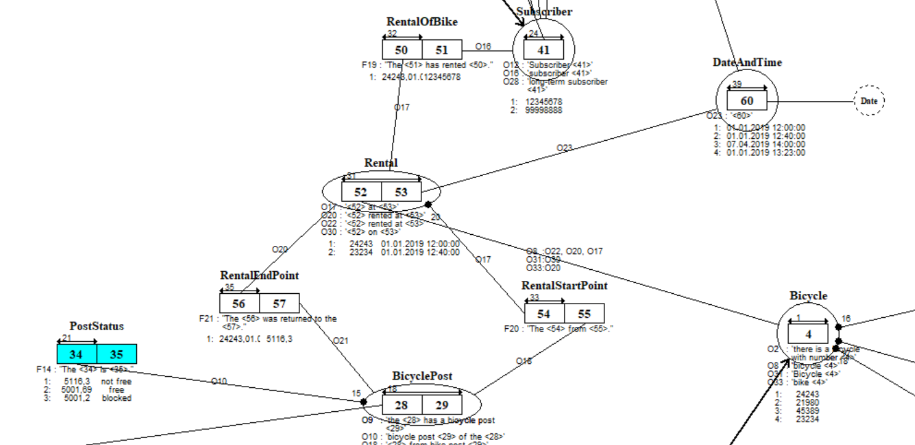
FCO-IM Model of subscriptions

Slide 23
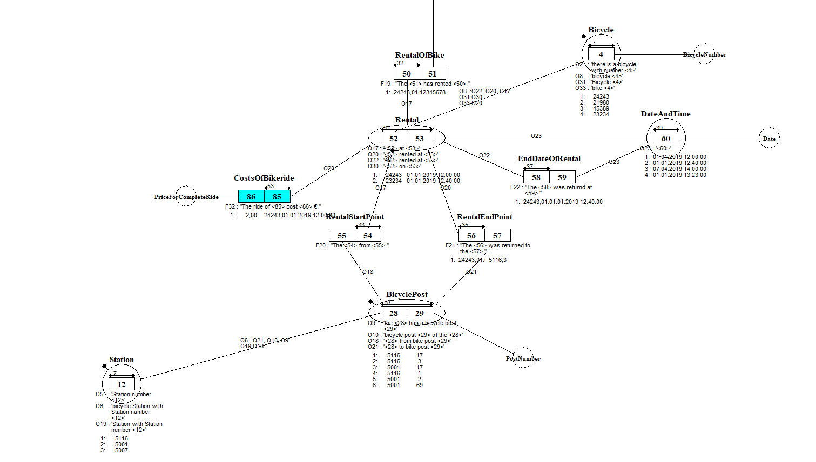
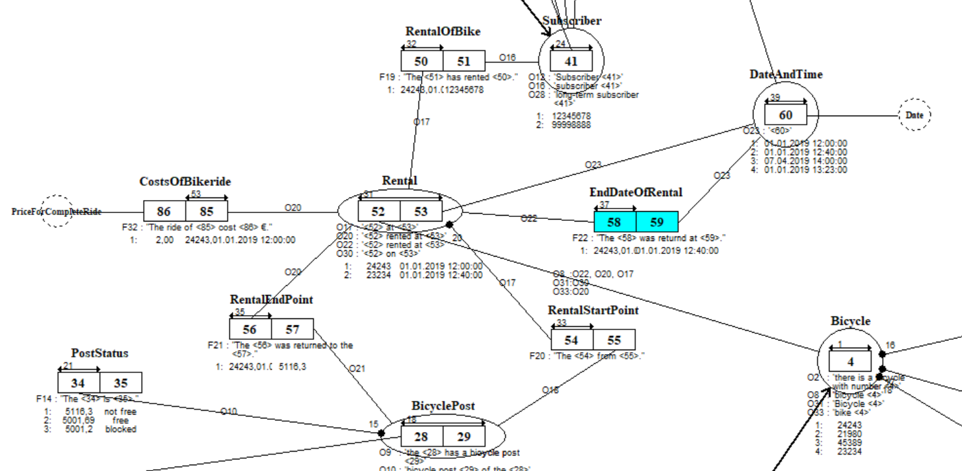
FCO-IM Model of subscriptions

Slide 24
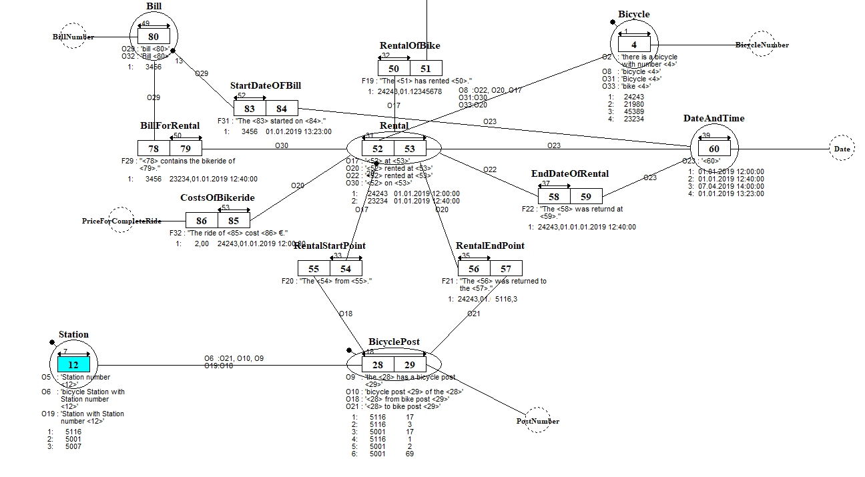
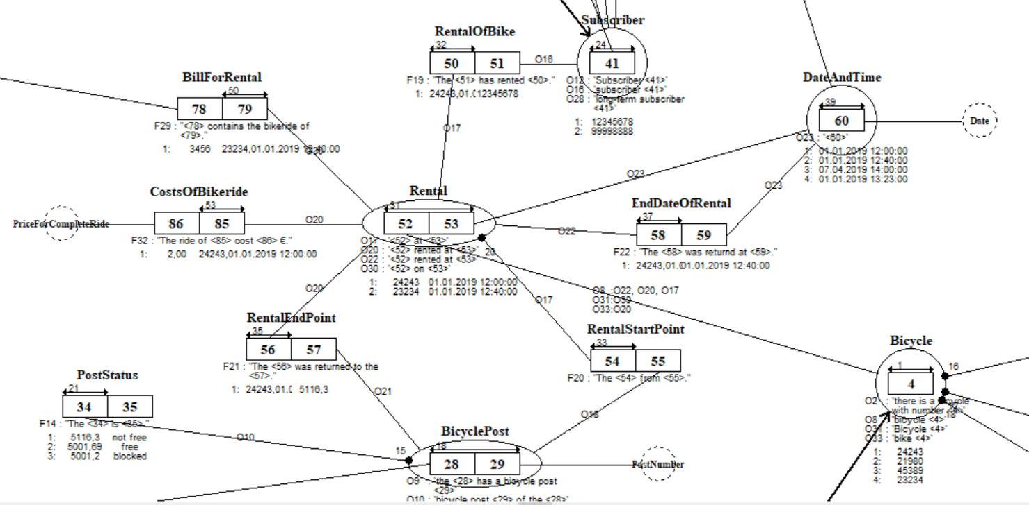
FCO-IM Model of subscriptions

Slide 25
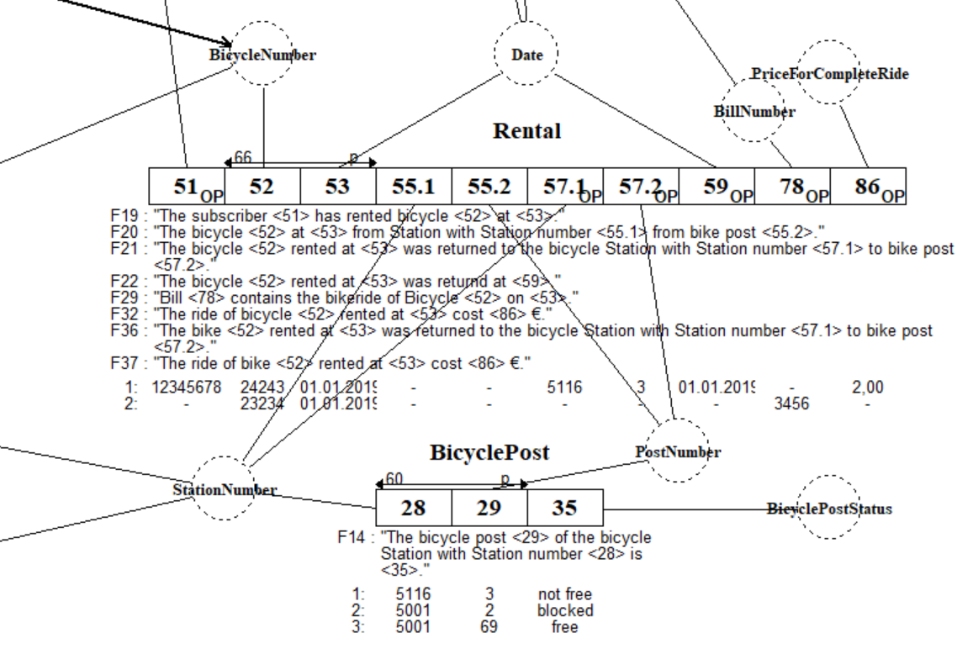

Slide 26
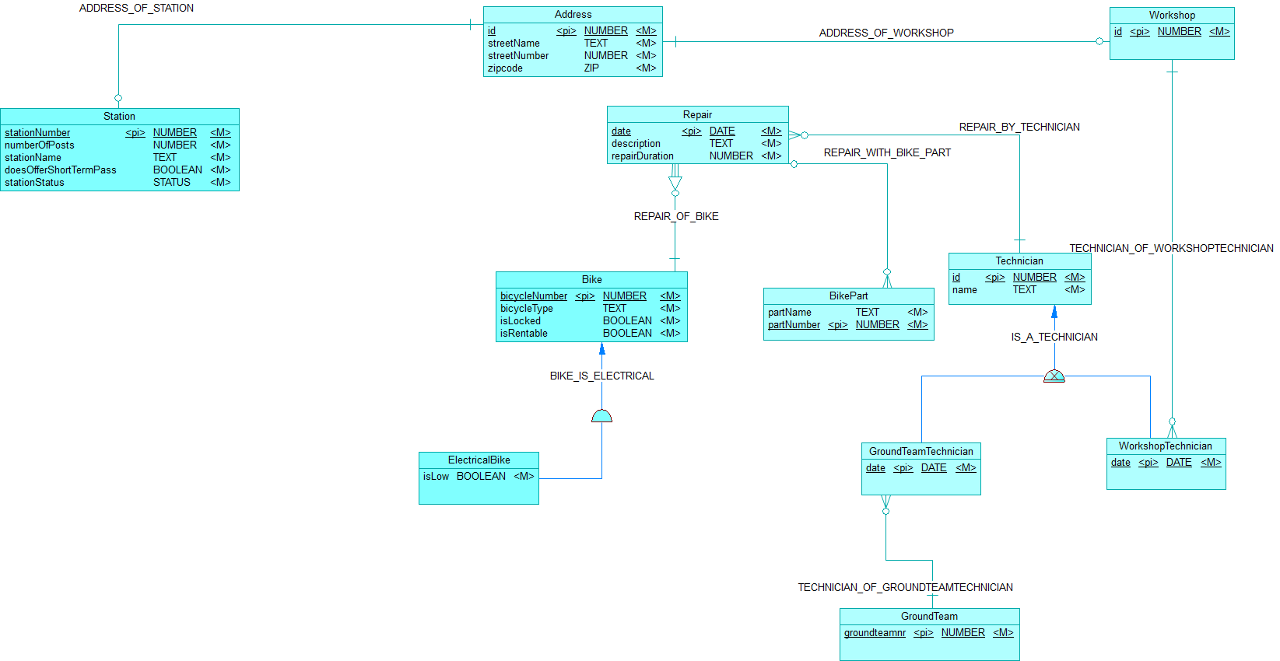
Maintenance
Notes:
Erik

Slide 27
Work process and experiences
Verbalization
Improvements the next day
Modeling in FCO-IM
Time
Modifications
WI-FI
Notes:
Verbalization in the beginning wasn’t that great because we were split, the next day it went a lot better because we created and discussed the verbalizations.
Modeling in FCO-IM didn’t go as smooth as we wanted because of the wording…
Modifying facts wasn’t an issue, everything was flexible
Jan or sabrina: verbalization, improvements the next day, modeling in FCO-IM, time
Jasmijn -> modifications, hostel and wi-fi

Slide 28
Any questions?

